Slide 1
Study information system -- Exa1--
Timotej Kotlín & Sara Alić-Ekinović

Slide 2



System Description :
Topic
  Exams (EXA)
Stakeholders
  Students
  Teachers
  Managers
Feature areas
  Awarding credits (by teachers)
  Exam terms management and room reservation (by teachers)
  Registering for the exam terms (by students)
  Communication with the registered students (by students and teachers)
  Awarding grades (by teachers)
  Viewing results (by students and teachers)
  Statistical reports going back to history (by managers and teachers)

Slide 3
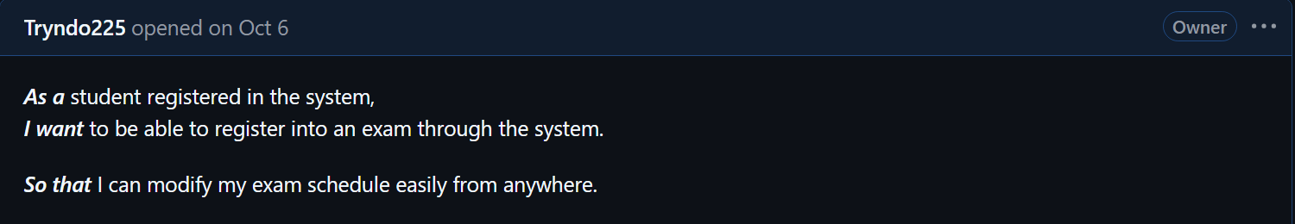
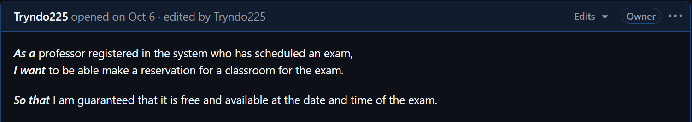
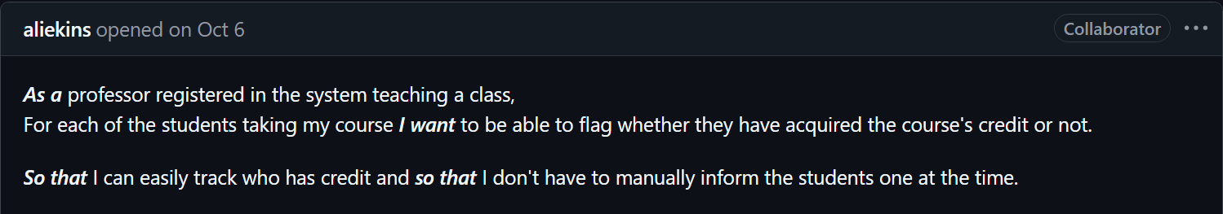
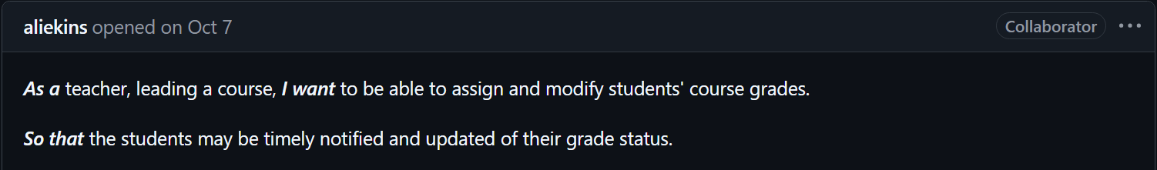
Features :

Slide 4

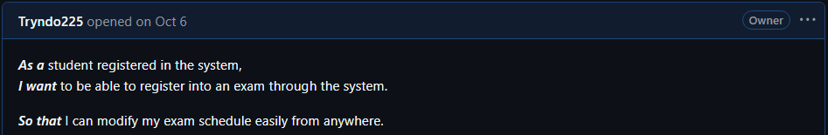
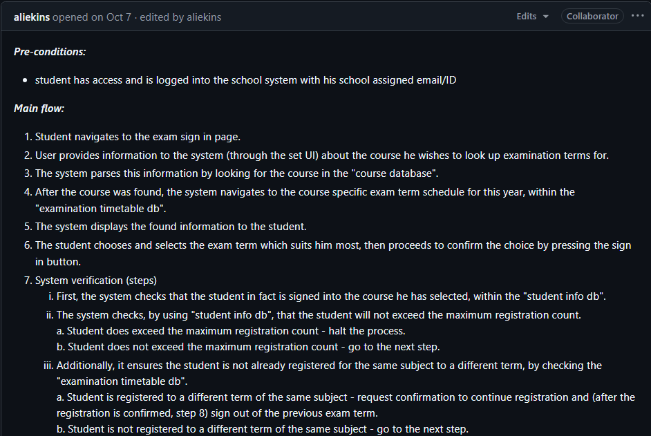
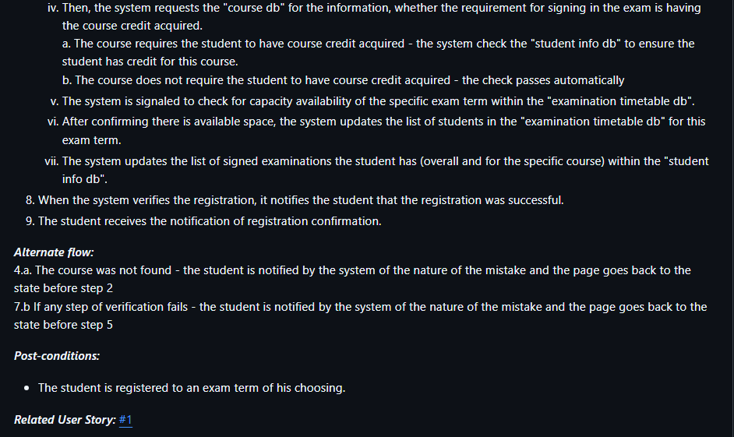
Student Exam Registration – Feature 01 :

Slide 5
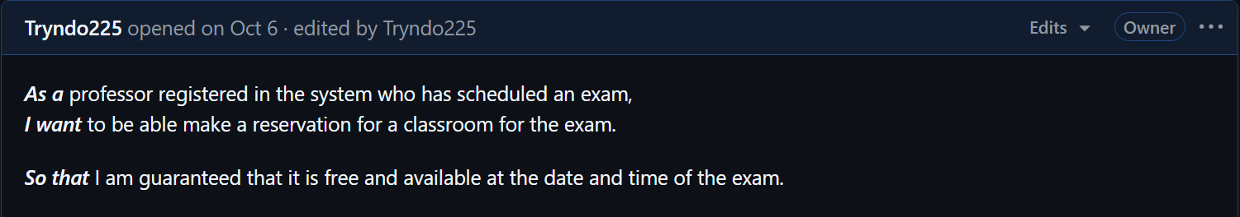
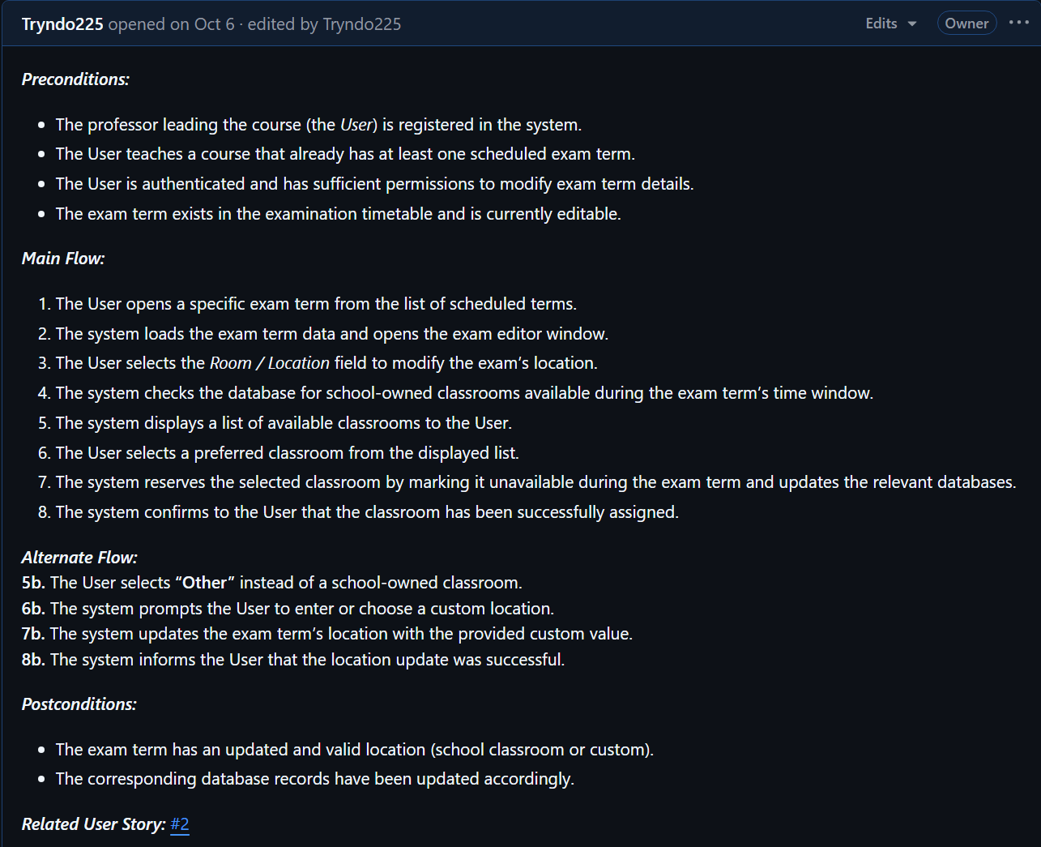

Reservation of Exam Premises – Feature 02 :

Slide 6
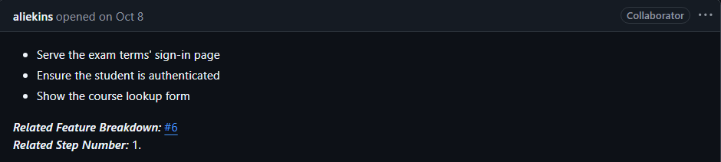
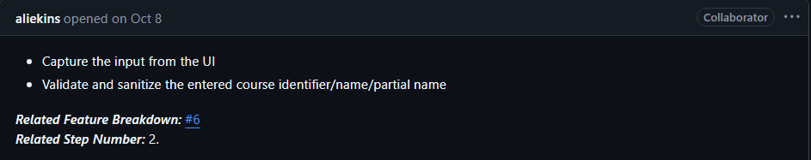
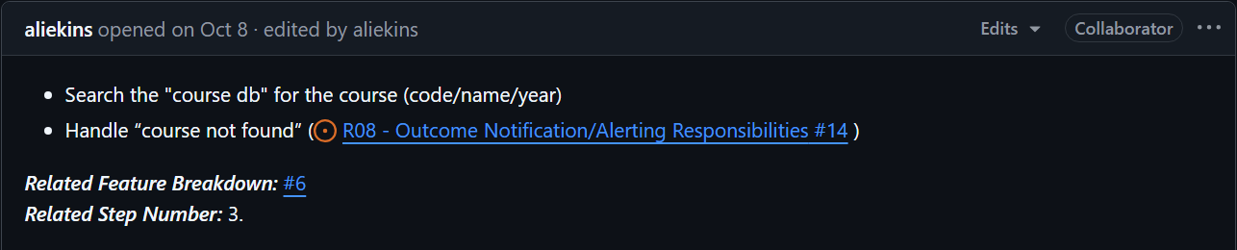
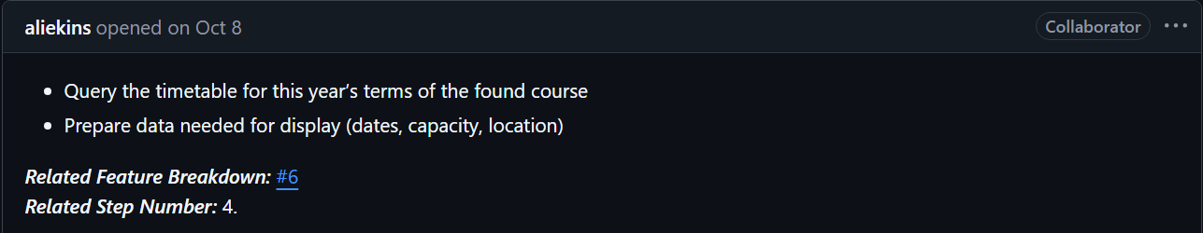
Responsibilities - Feature 01 :
R01 - Exam Term Sign-In Page And Authentication Guard
R02 - Course Lookup Input Handling
R03 - Course Resolution In Course DB
R04 - Term Schedule Retrieval

Slide 7
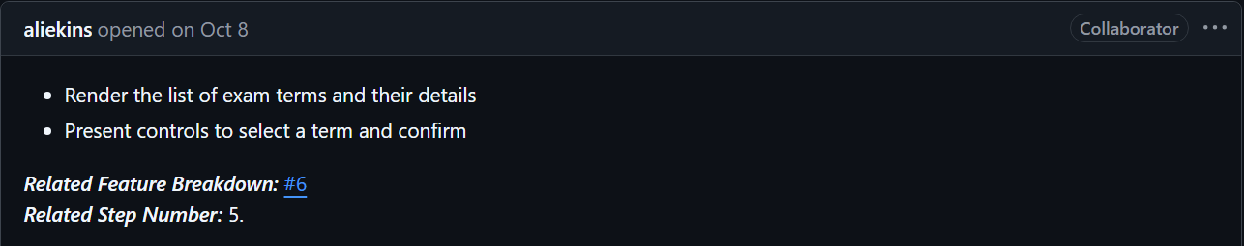
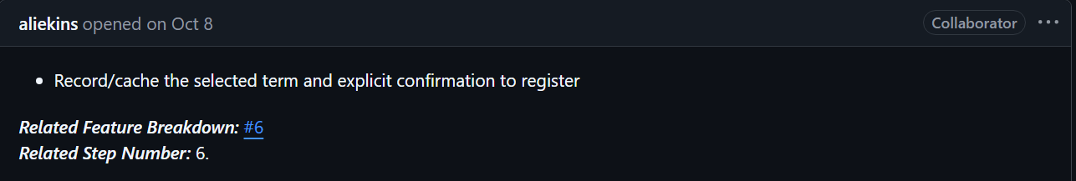
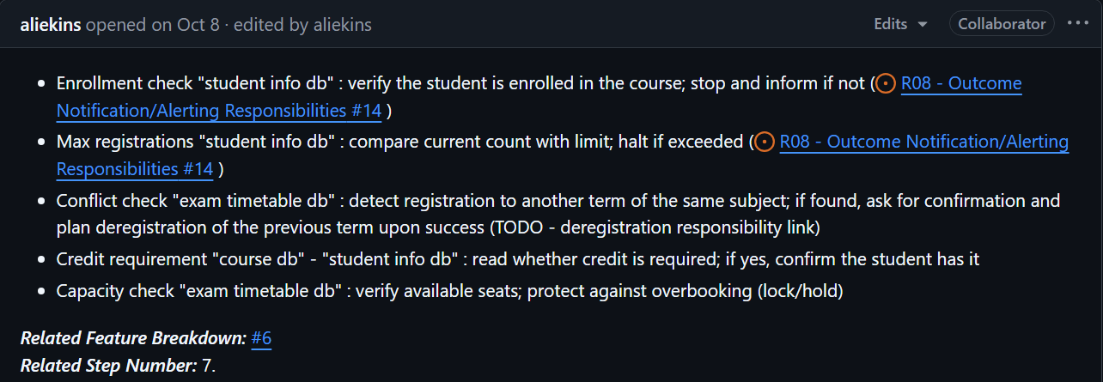
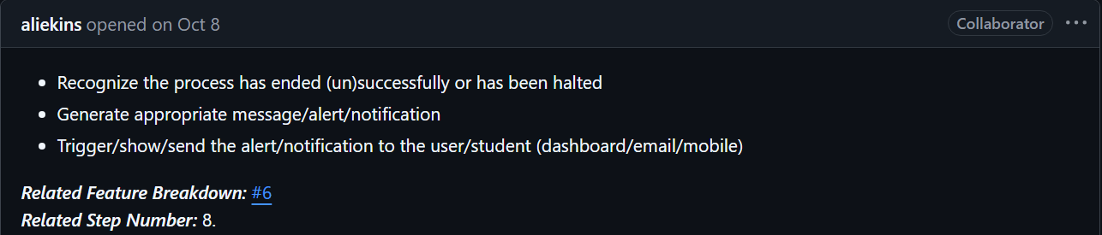
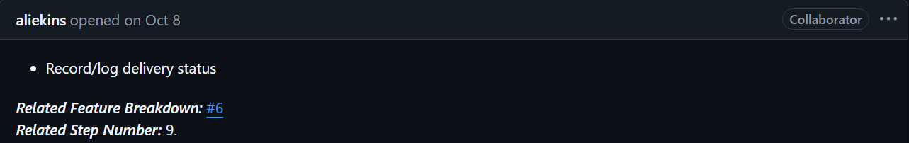
R05 - Exam Term(s) Presentation
R06 - Exam Term Selection Capture
R07 - Registration/Enrolment Verification
R08 - Outcome Notification/Alerting Responsibilities
R09 - Notification/Alert Logging

Slide 8
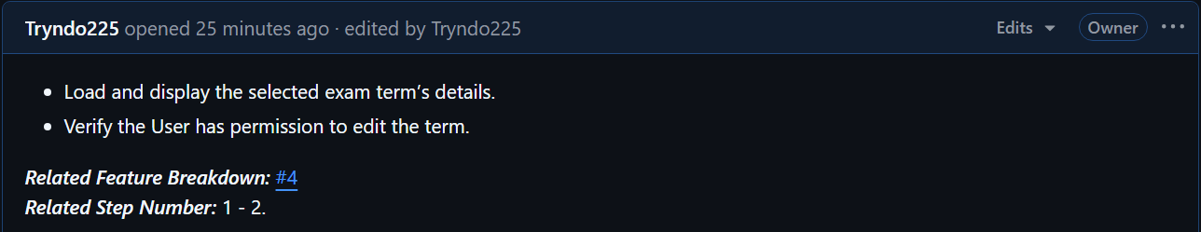
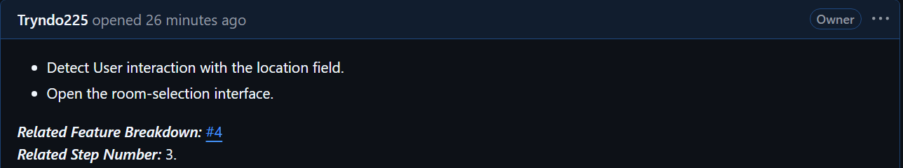
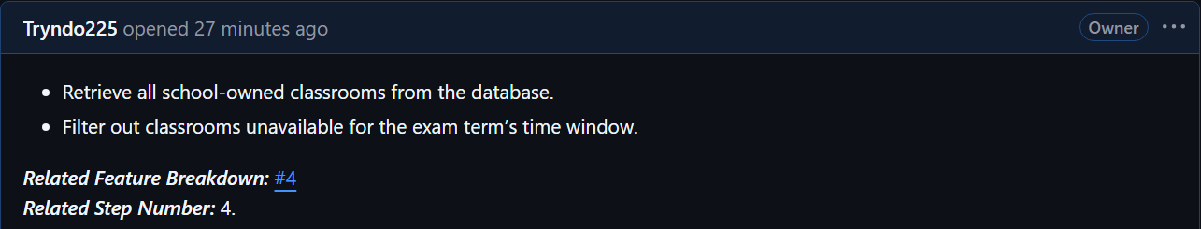
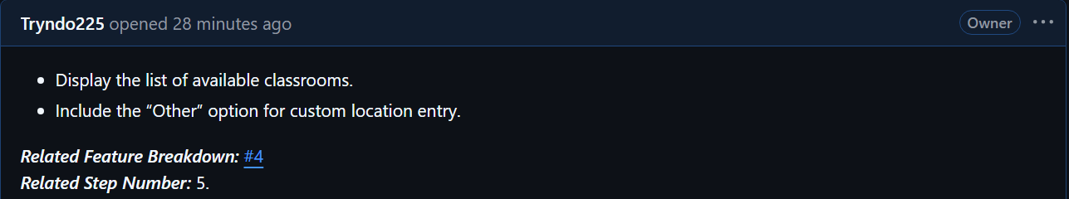
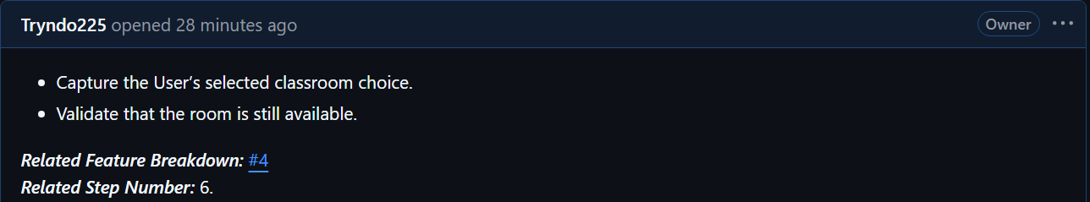
Responsibilities - Feature 02 :
R10 - Exam Term Editor Initialization
R11 - Location Field Activation
R12 - Classroom Availability Lookup
R13 - Room Option Presentation
R14 - Classroom Selection Handling

Slide 9
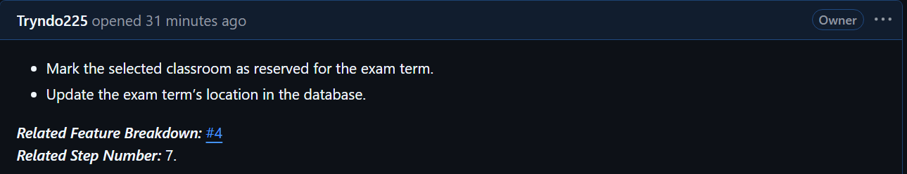
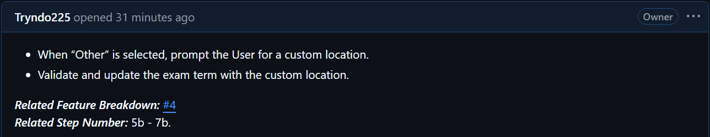
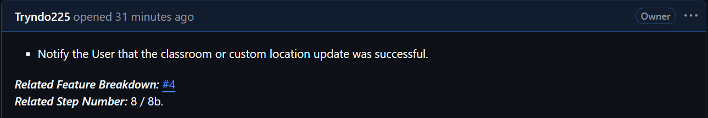
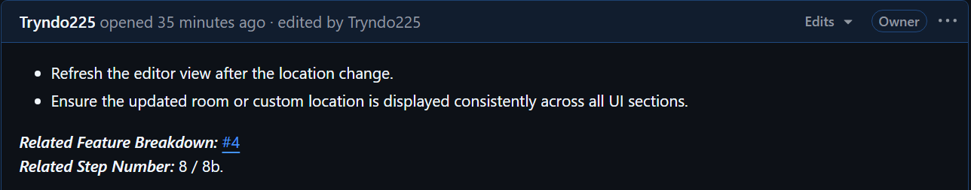
R15 - Classroom Reservation & Persistence
R16 - Custom Location Handling
R17 - Success Notification
R18 - Editor State Refresh & UI Consistency

Slide 10
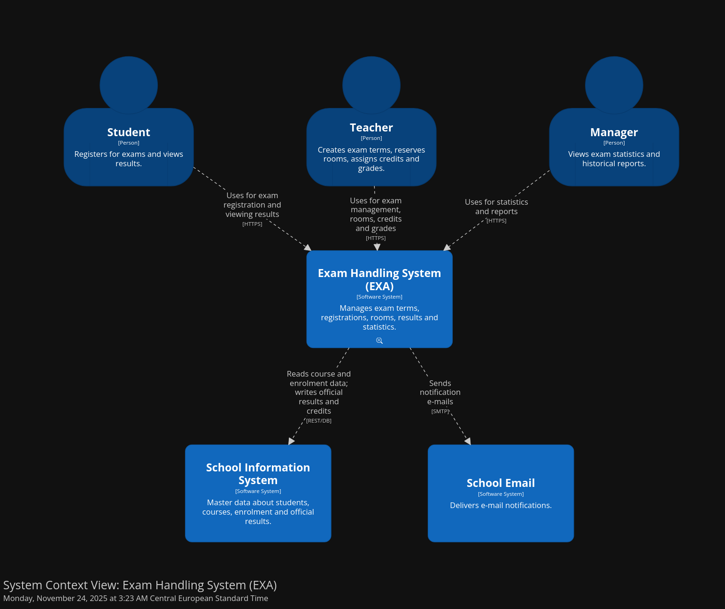
L1 Diagram – C4:

Slide 11
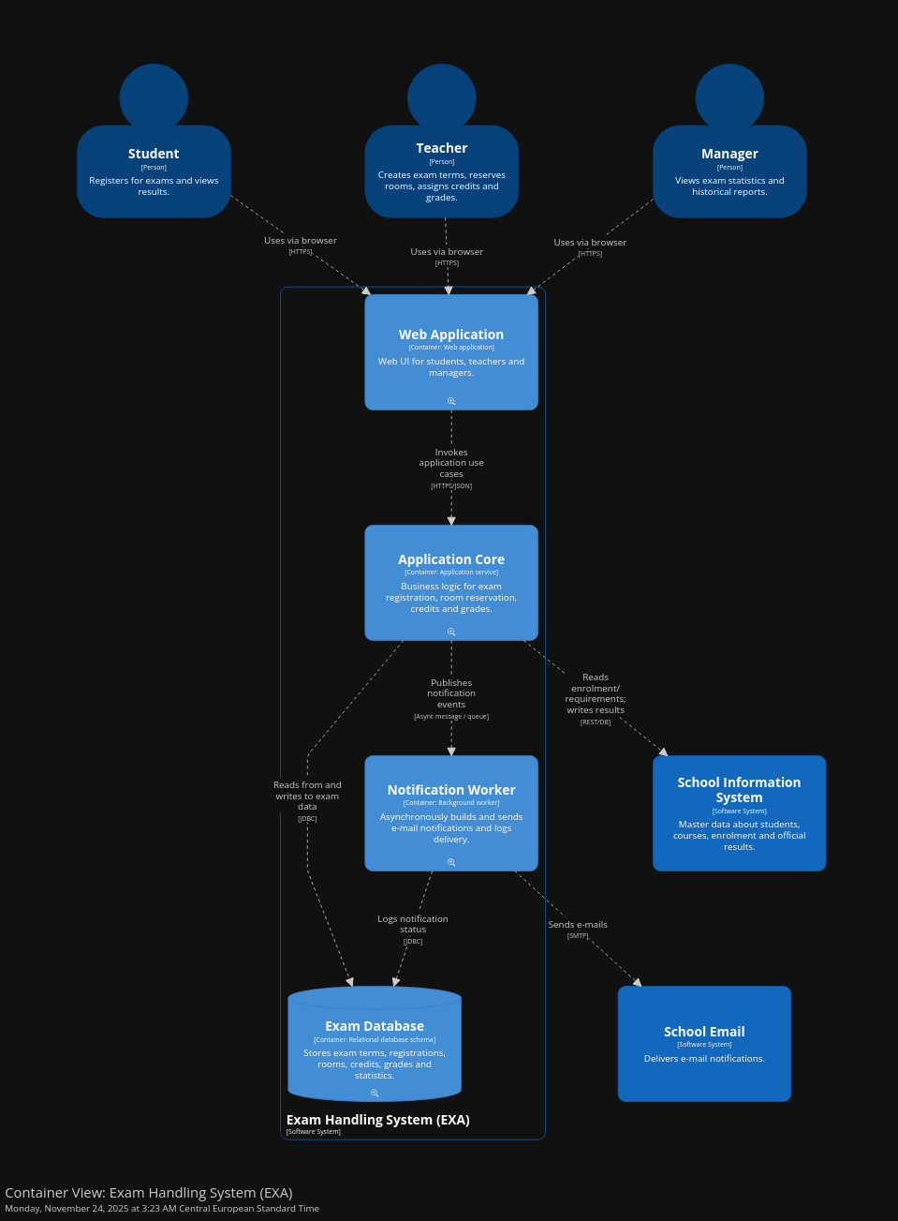
L2 Diagram – C4:

Slide 13
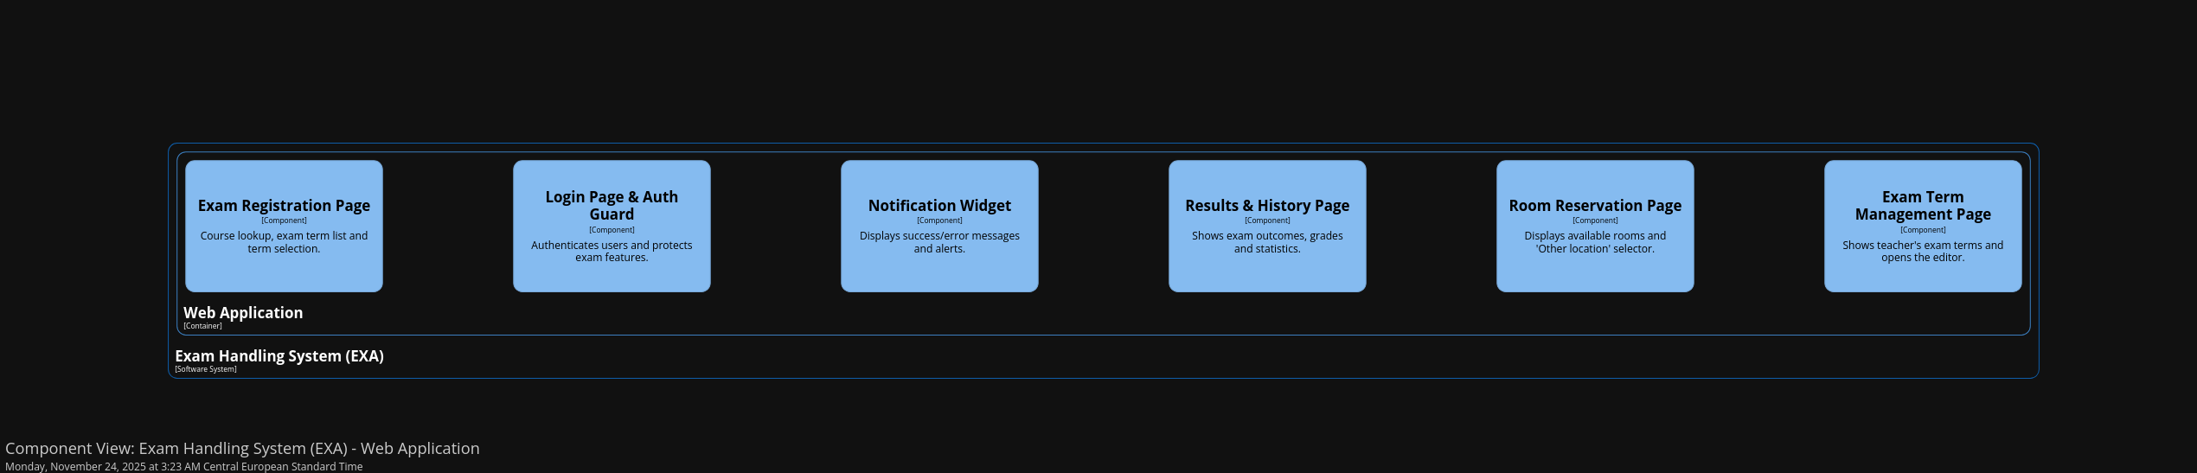
L3 Diagram - Web Application - C4:

Slide 15
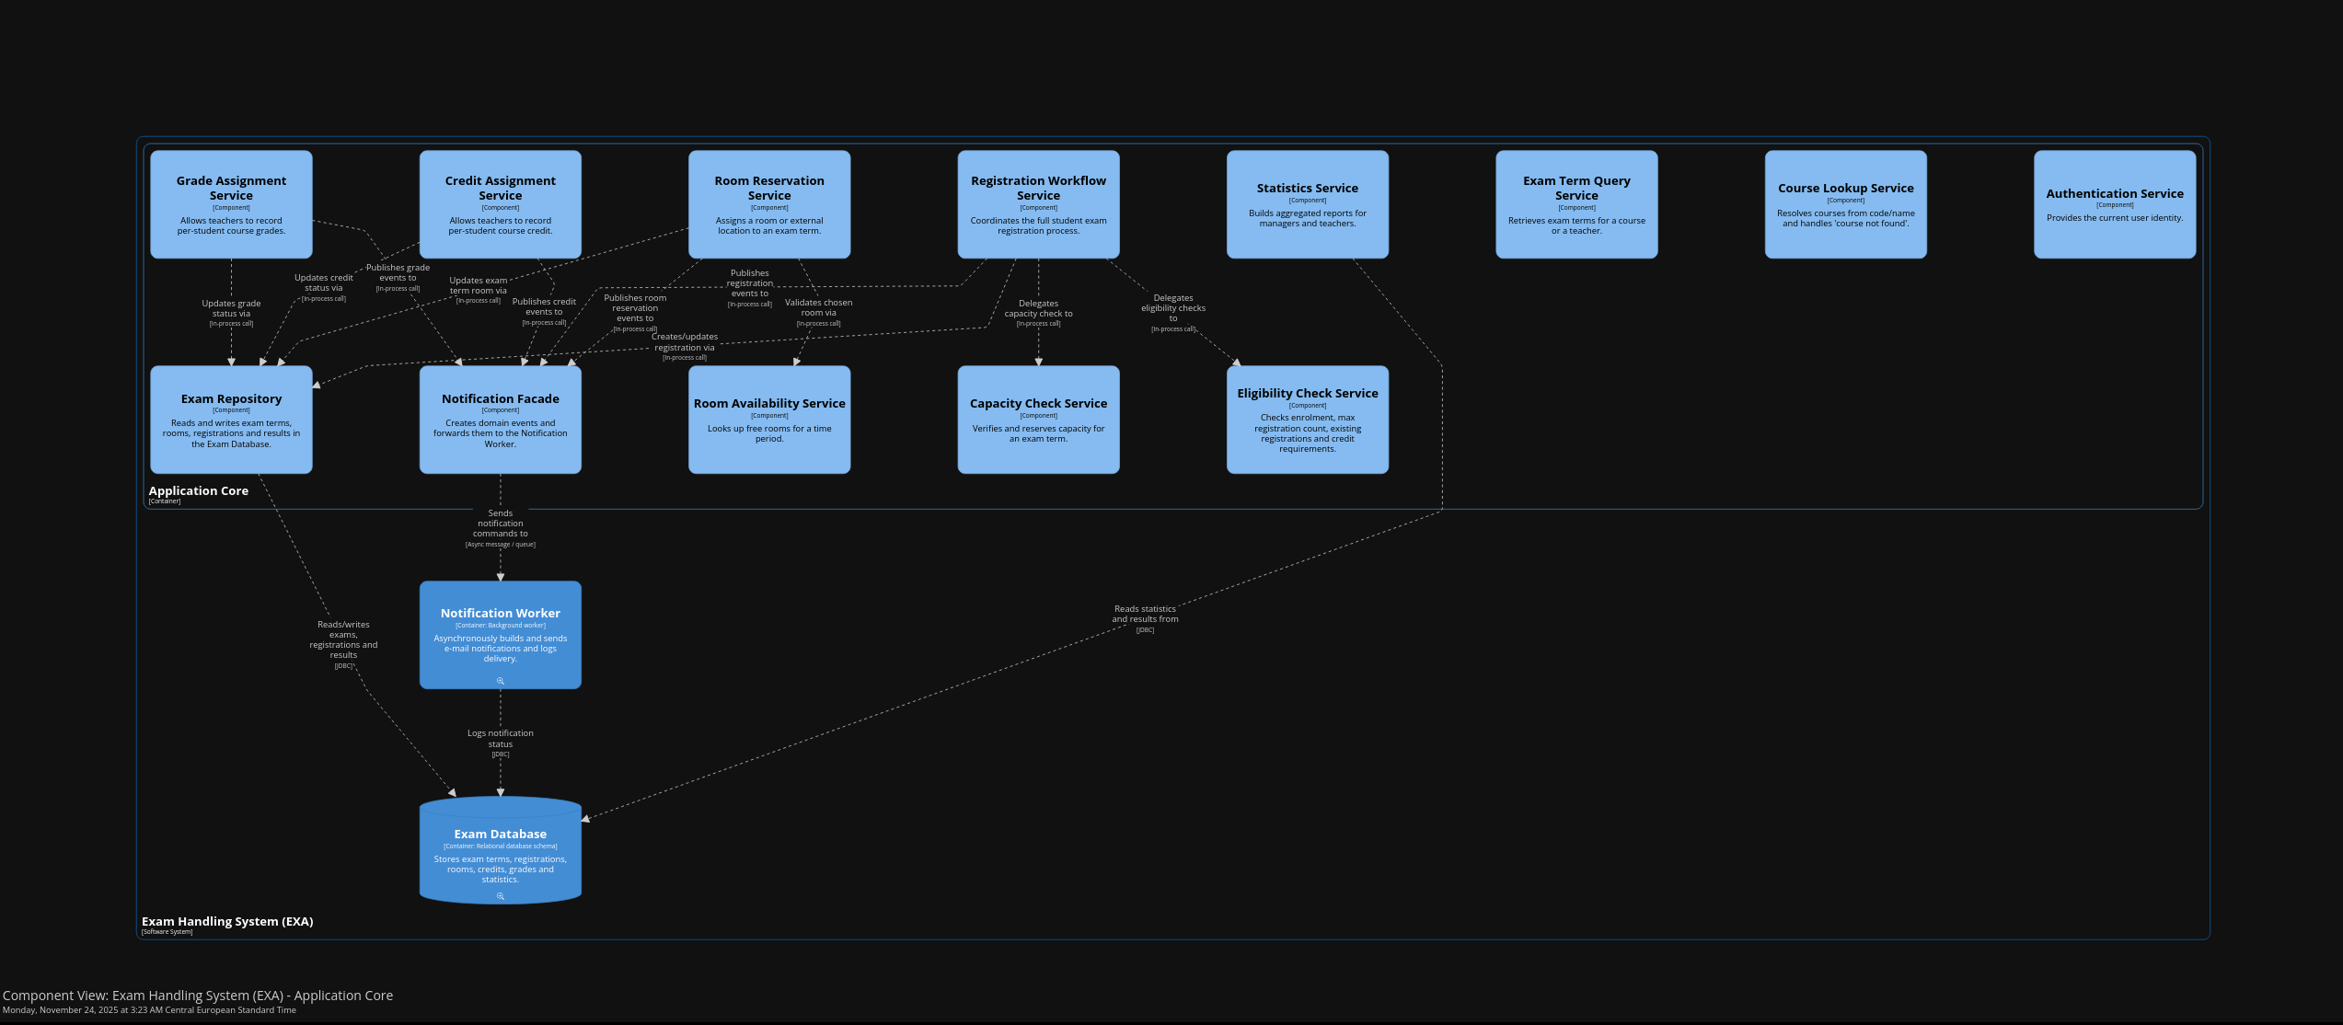
L3 Diagram – Application Core - C4:

Slide 18
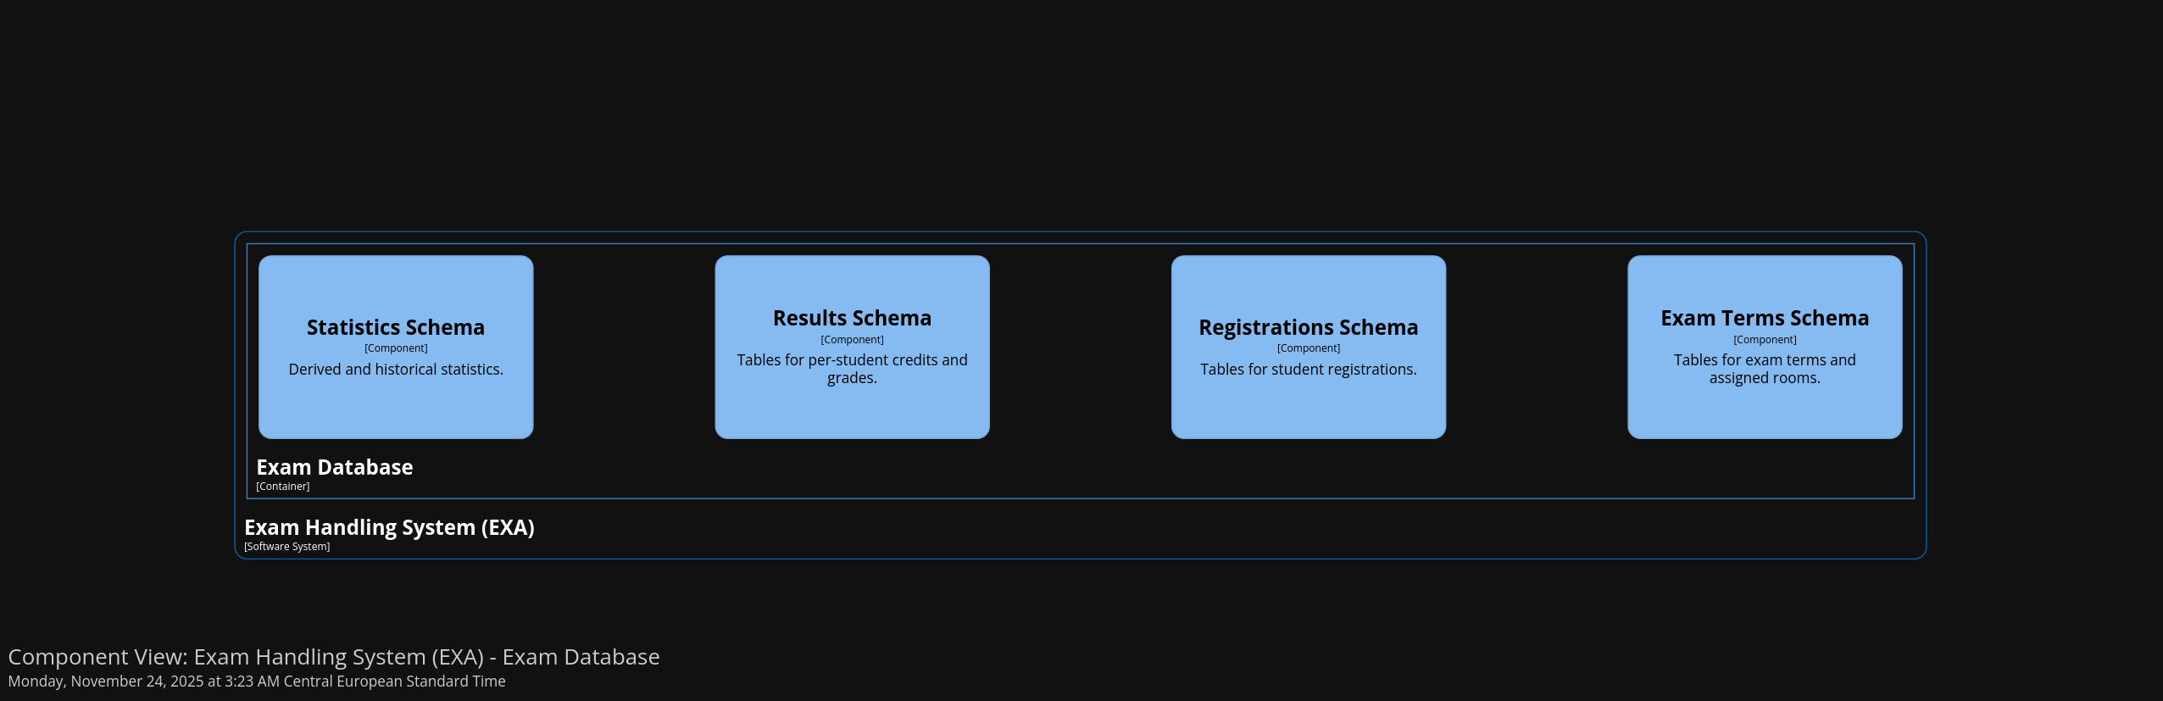
L3 Diagram – Exam Database - C4:

Slide 19
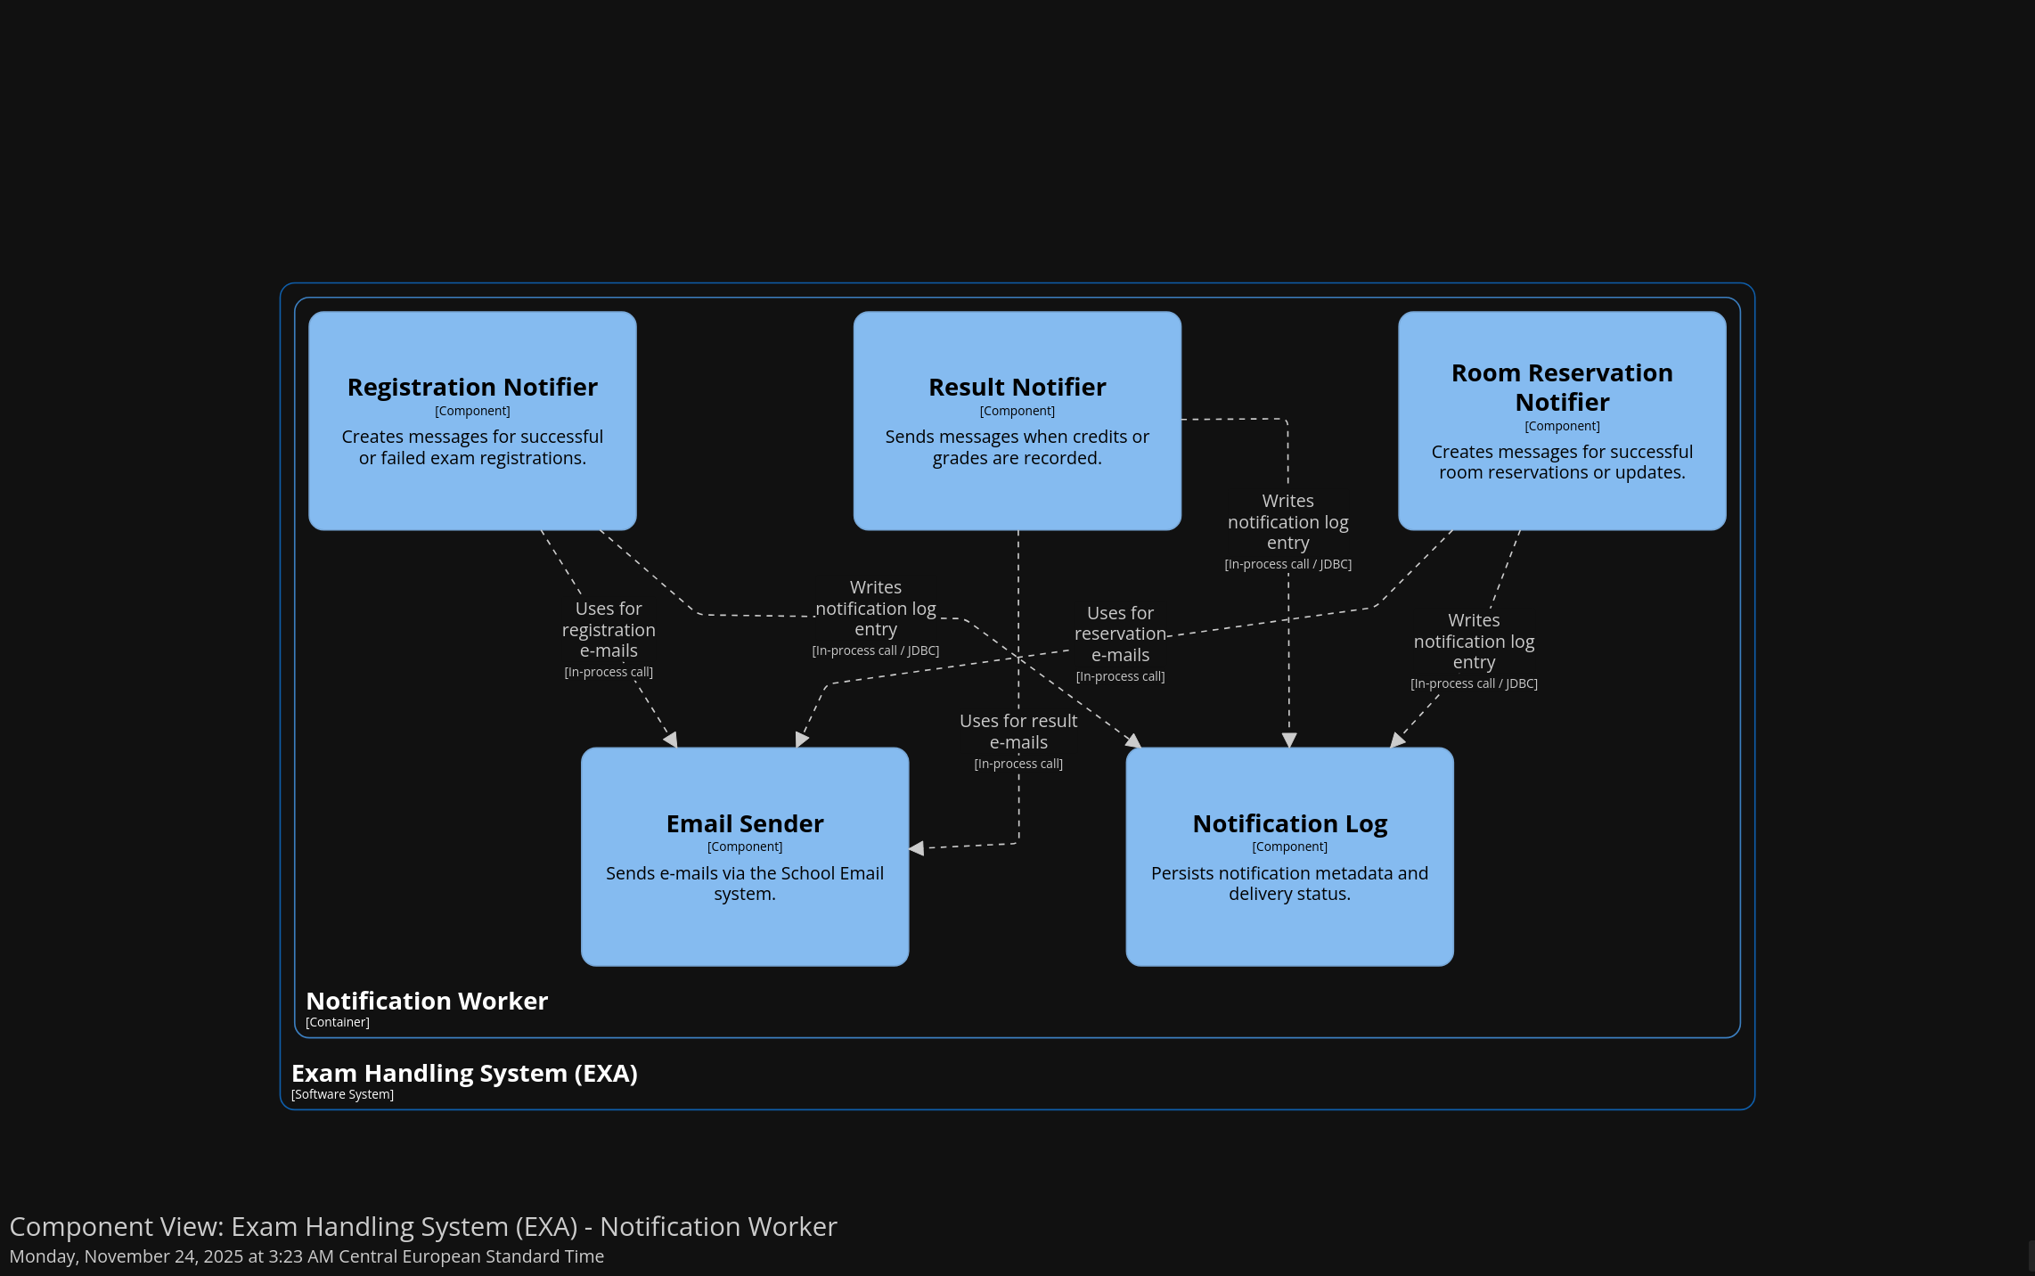
L3 Diagram – Notification Worker - C4:

Slide 20
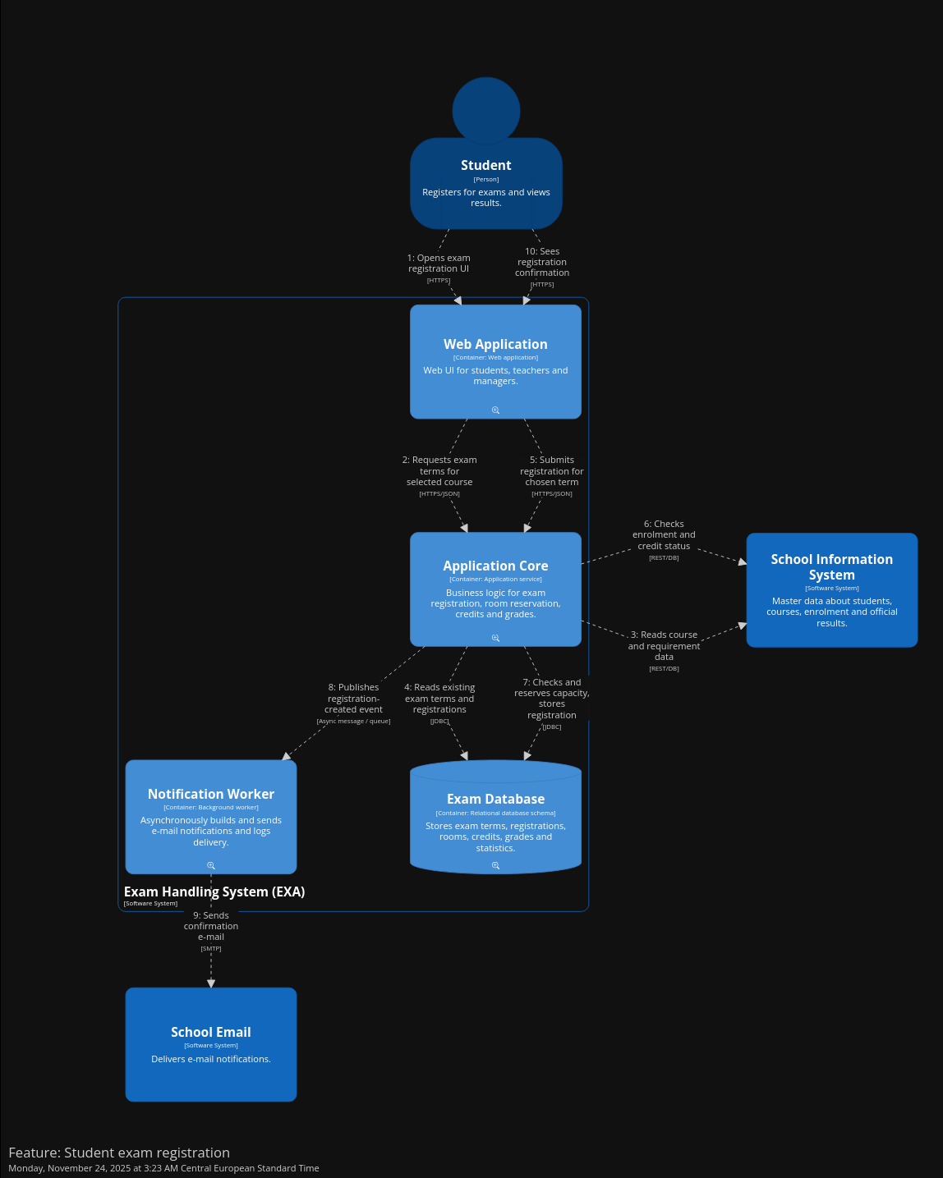
Feature 01 flow - C4:

Slide 22
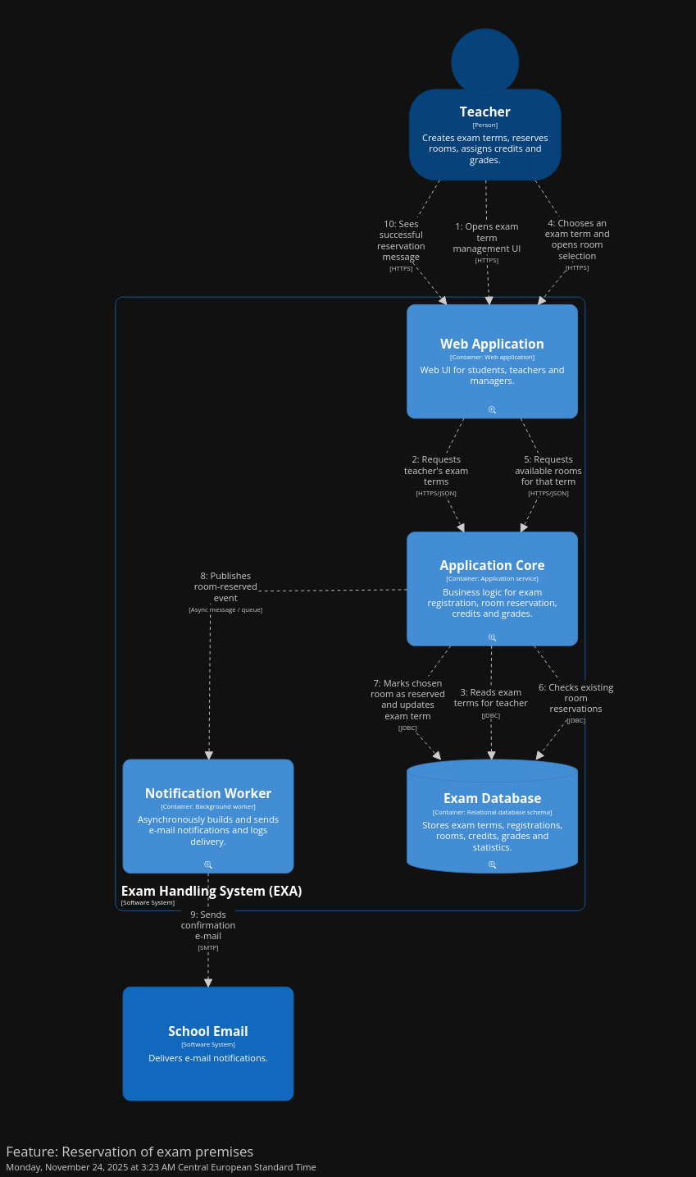
Feature 02 flow - C4:

Slide 26
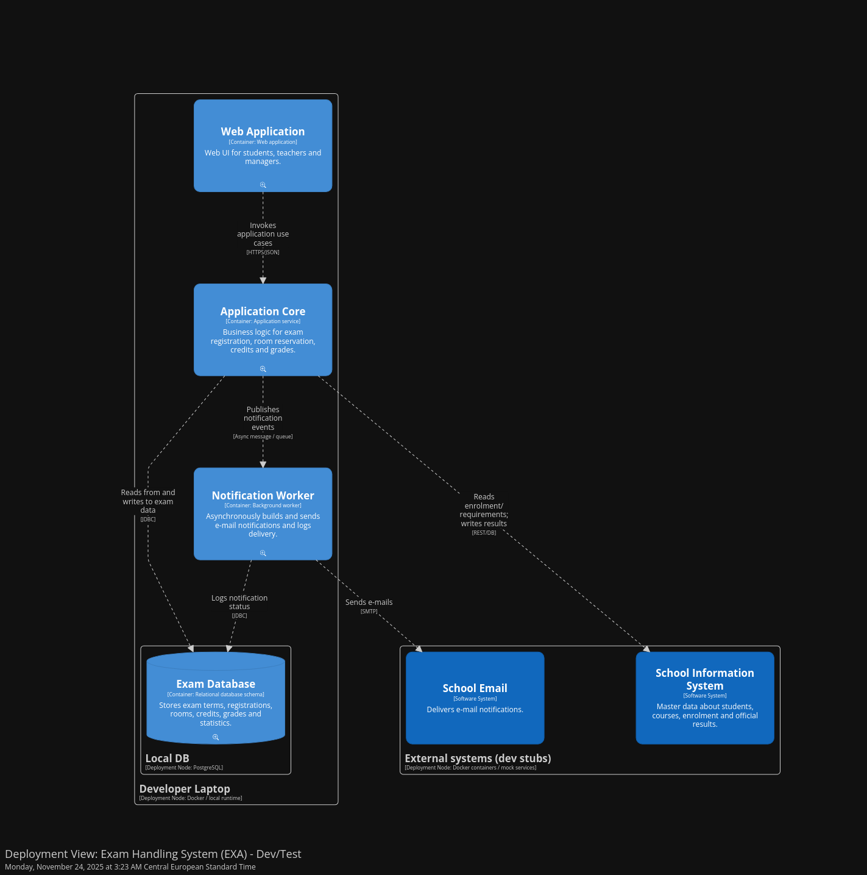
Deployment (Development) - C4:

Slide 29
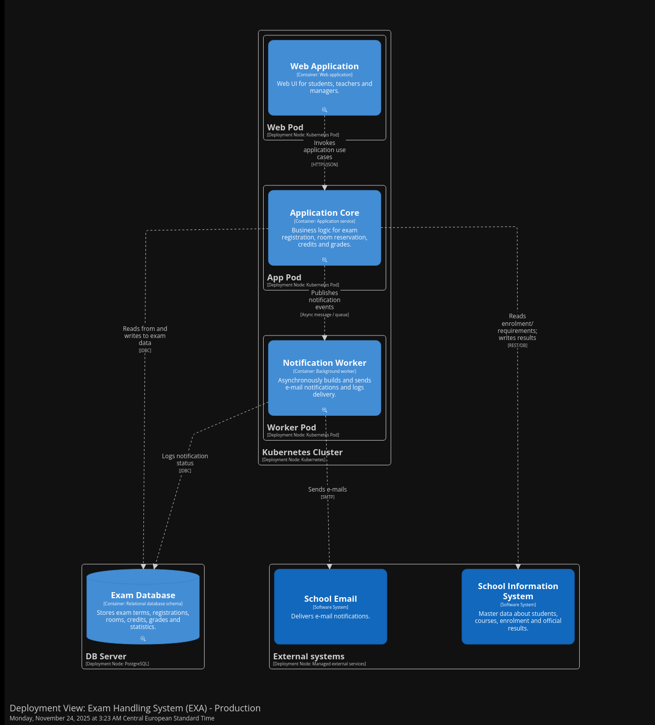
Deployment (Production) - C4:

Slide 32
Thank You For your attention

